Slide 1

COMP1860 Building our Digital World: Computer Systems & Architecture
S1.W3.L2: Boolean Logic & Logic Gates
Dr James Dyer

Slide 2


Slide 3
Text Book
This lecture covers material similar to chapter 12 of Stallings. Computer Organisation & Architecture
  It covers sections 12.1 and 12.2 of chapter 12

Slide 4
Learning Outcomes
Construct a logic circuit using logic gates.

Slide 5
Overview
Boolean Logic
Logic Circuits

Slide 6
Boolean Logic

Slide 7
Boolean Algebra
Mathematical logic
  Each Boolean variable has 2 possible values: True and False
Named after George Boole
  English mathematician
  Proposed basic principles of the algebra in 1854

Slide 8


Boolean Values
On
True
Yes
1
Off
False
No
0

Slide 9
Number of possible values
1 variable: 2 possible values, 0 or 1
2 variables: 4 possible combinations – 00, 01, 10, 11
3 variables: 8 possible combinations – 000, 001, 010, 011, 100, 101, 110, 111
n variables: 2^{n} possible combinations

Slide 10
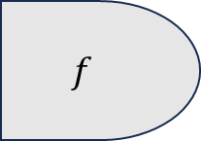

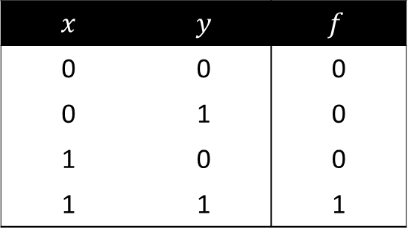



Boolean functions
$$x$$ | $$y$$ | $$f$$
0 | 0 | 0
0 | 1 | 0
1 | 0 | 0
1 | 1 | 1
$$x$$
$$f$$
$$f(x,y)$$
$$y$$
$$f\left(x,y\right)=\left\{\begin{aligned}1 when x=1 and y=1 \\ 0 otherwise\end{aligned}\right.$$

Slide 11
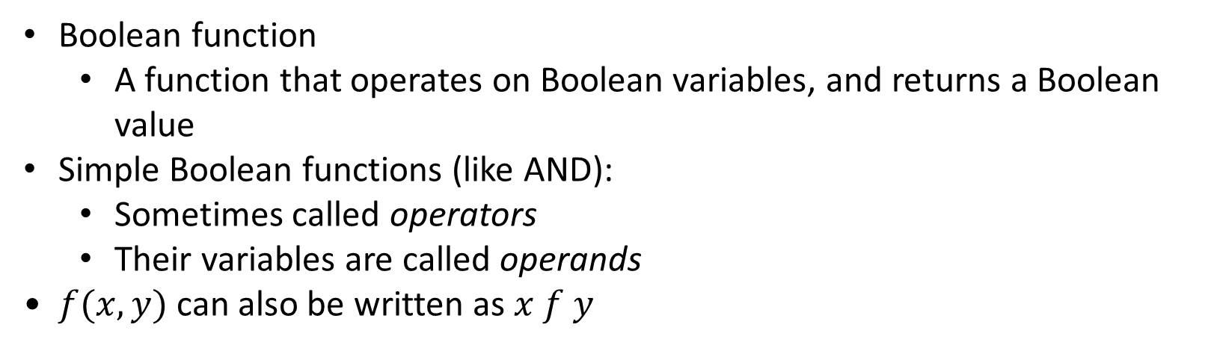
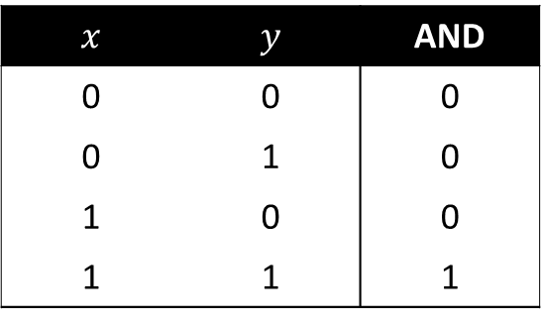


Boolean functions
$$x$$ | $$y$$ | AND
0 | 0 | 0
0 | 1 | 0
1 | 0 | 0
1 | 1 | 1
$$x$$
AND
AND$(x,y)$
$$y$$
AND$\left(x,y\right)=\left\{\begin{aligned}1 when x=1 and y=1 \\ 0 otherwise\end{aligned}\right.$
Boolean function
  A function that operates on Boolean variables, and returns a Boolean value
Simple Boolean functions (like AND):
  Sometimes called operators
  Their variables are called operands
• $f(x,y)$ can also be written as $x f y$

Slide 12

Truth tables
The table from the previous slides is an example of a truth table
It show all possible combinations of the inputs
Output for each combination
$$x$$ | $$y$$ | AND
0 | 0 | 0
0 | 1 | 0
1 | 0 | 0
1 | 1 | 1

Slide 13

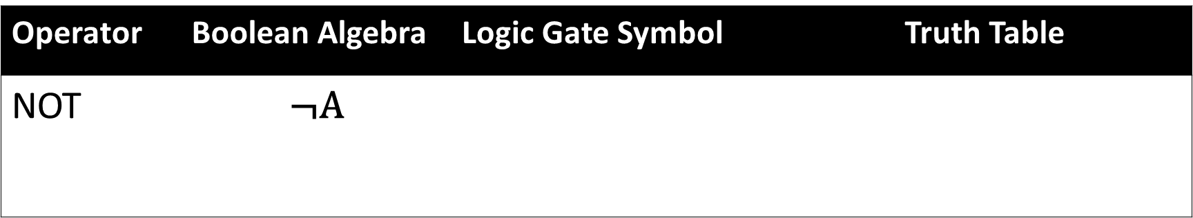
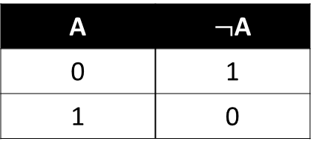
Boolean Operators
Operator | Boolean Algebra | Logic Gate Symbol | Truth Table
NOT | $$\text{¬}\text{A}$$
A | $¬$A
0 | 1
1 | 0

Slide 14


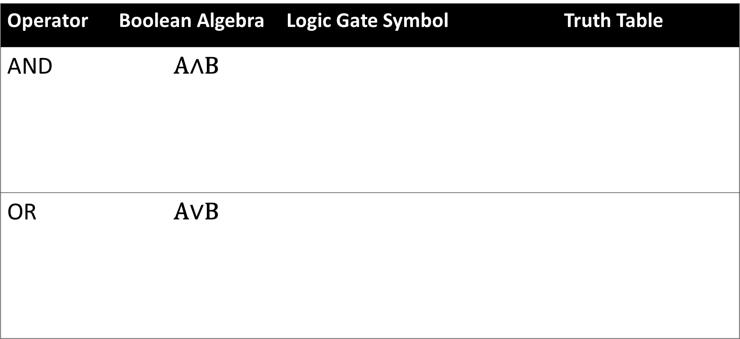
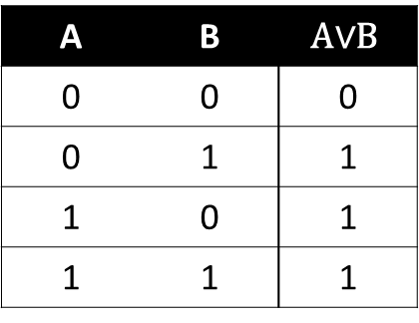
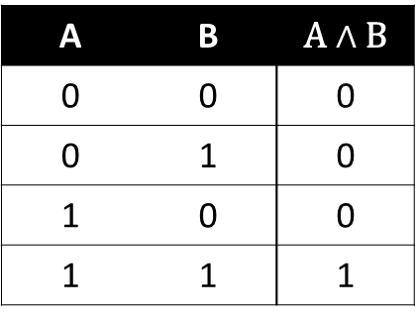
Boolean Operators
Operator | Boolean Algebra | Logic Gate Symbol | Truth Table
AND | $$\text{A}\text{∧}\text{B}$$
OR | $$\text{A}\text{∨}\text{B}$$
A | B | $$\text{A}∧\text{B}$$
0 | 0 | 0
0 | 1 | 0
1 | 0 | 0
1 | 1 | 1
A | B | $$\text{A}\text{∨}\text{B}$$
0 | 0 | 0
0 | 1 | 1
1 | 0 | 1
1 | 1 | 1

Slide 15



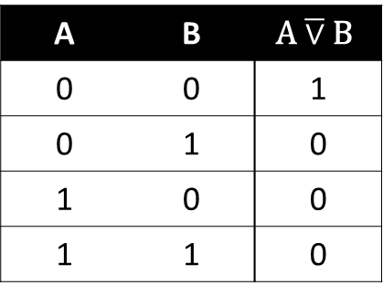
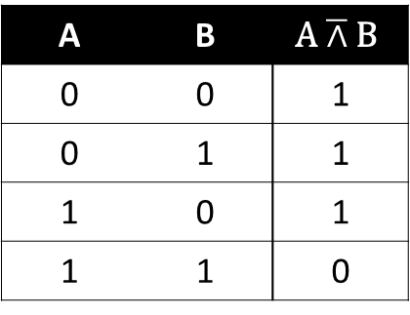
Boolean Operators
Operator | Boolean Algebra | Logic Gate Symbol | Truth Table
NAND | $\text{A}\overline{∧}\text{B}$ or $A↑B$
NOR | $\text{A}\overline{∨}\text{B}$ or $A↓B$
A | B | $$\text{A}\overline{∧}\text{B}$$
0 | 0 | 1
0 | 1 | 1
1 | 0 | 1
1 | 1 | 0
A | B | $$\text{A}\overline{∨}\text{B}$$
0 | 0 | 1
0 | 1 | 0
1 | 0 | 0
1 | 1 | 0

Slide 16


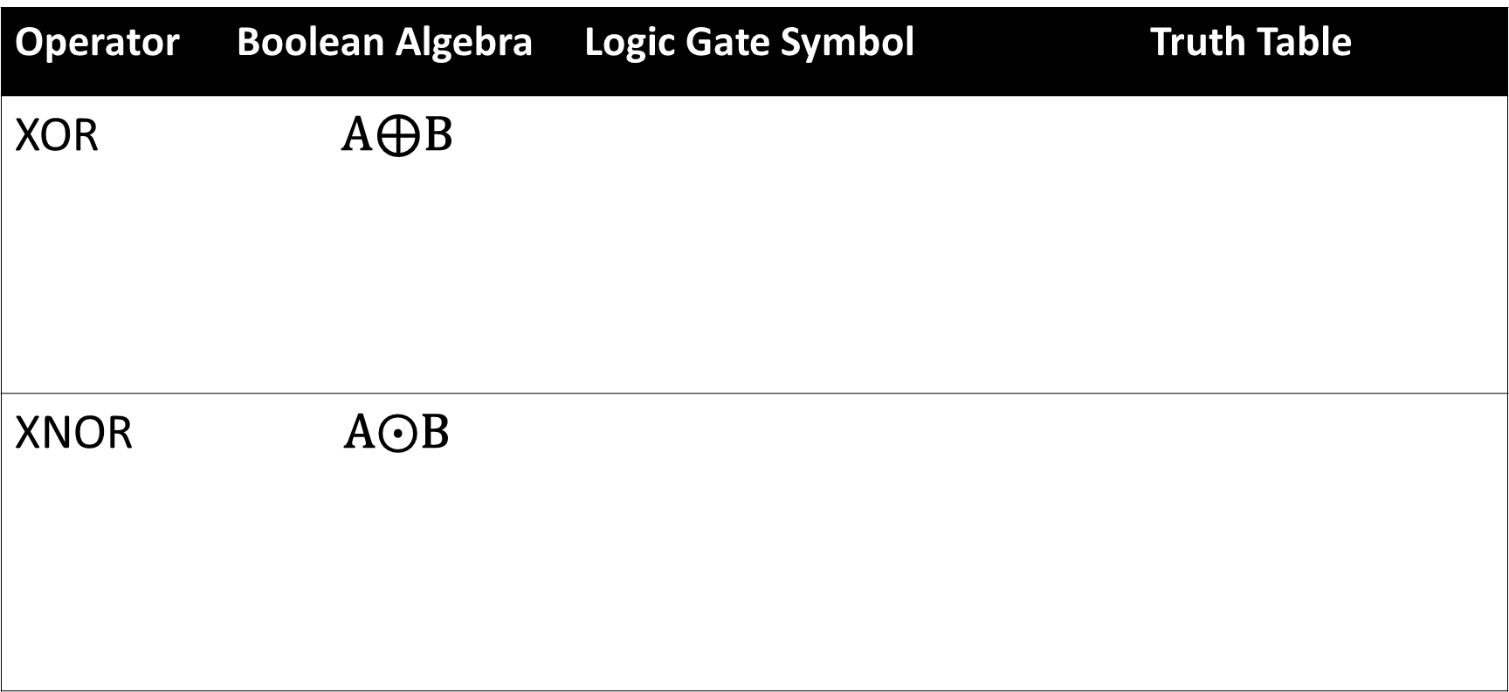
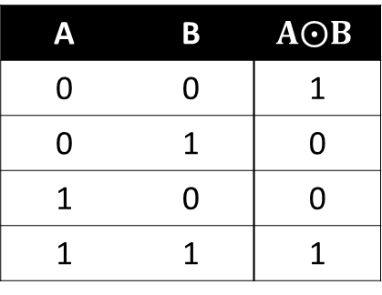
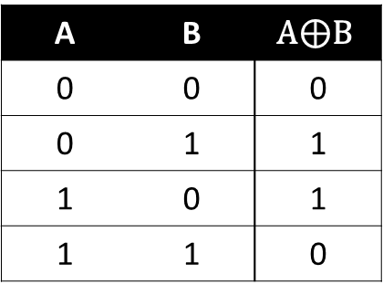
Boolean Operators
Operator | Boolean Algebra | Logic Gate Symbol | Truth Table
XOR | $$\text{A}\text{⊕}\text{B}$$
XNOR | $$\text{A}⨀\text{B}$$
A | B | $$\text{A}\text{⊕}\text{B}$$
0 | 0 | 0
0 | 1 | 1
1 | 0 | 1
1 | 1 | 0
A | B | $$A⨀B$$
0 | 0 | 1
0 | 1 | 0
1 | 0 | 0
1 | 1 | 1

Slide 17
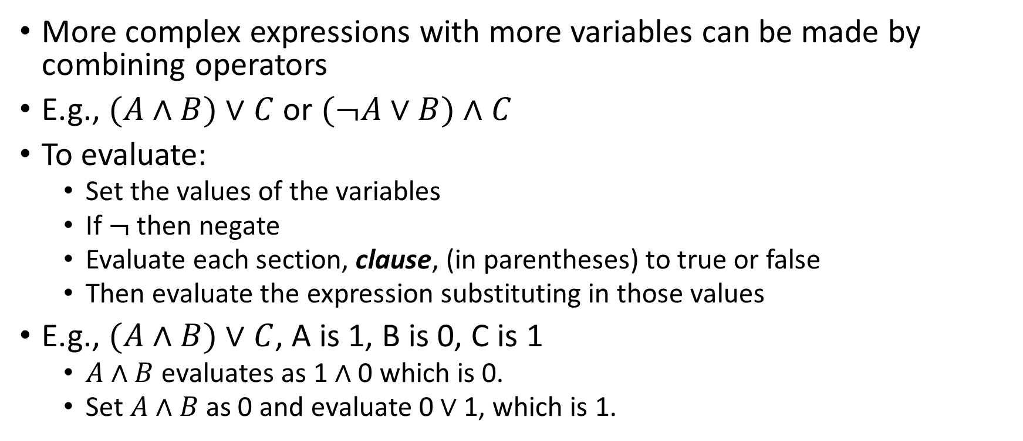
Boolean Logic
More complex expressions with more variables can be made by combining operators
E.g., $(A∧B)∨C$ or $(¬A∨B)∧C$
To evaluate:
  Set the values of the variables
  If $¬$ then negate
  Evaluate each section, clause, (in parentheses) to true or false
  Then evaluate the expression substituting in those values
E.g., $(A∧B)∨C$, A is 1, B is 0, C is 1
  $A∧B$ evaluates as 1 $∧$ 0 which is 0.
  Set $A∧B$ as 0 and evaluate 0 $∨$ 1, which is 1.

Slide 18
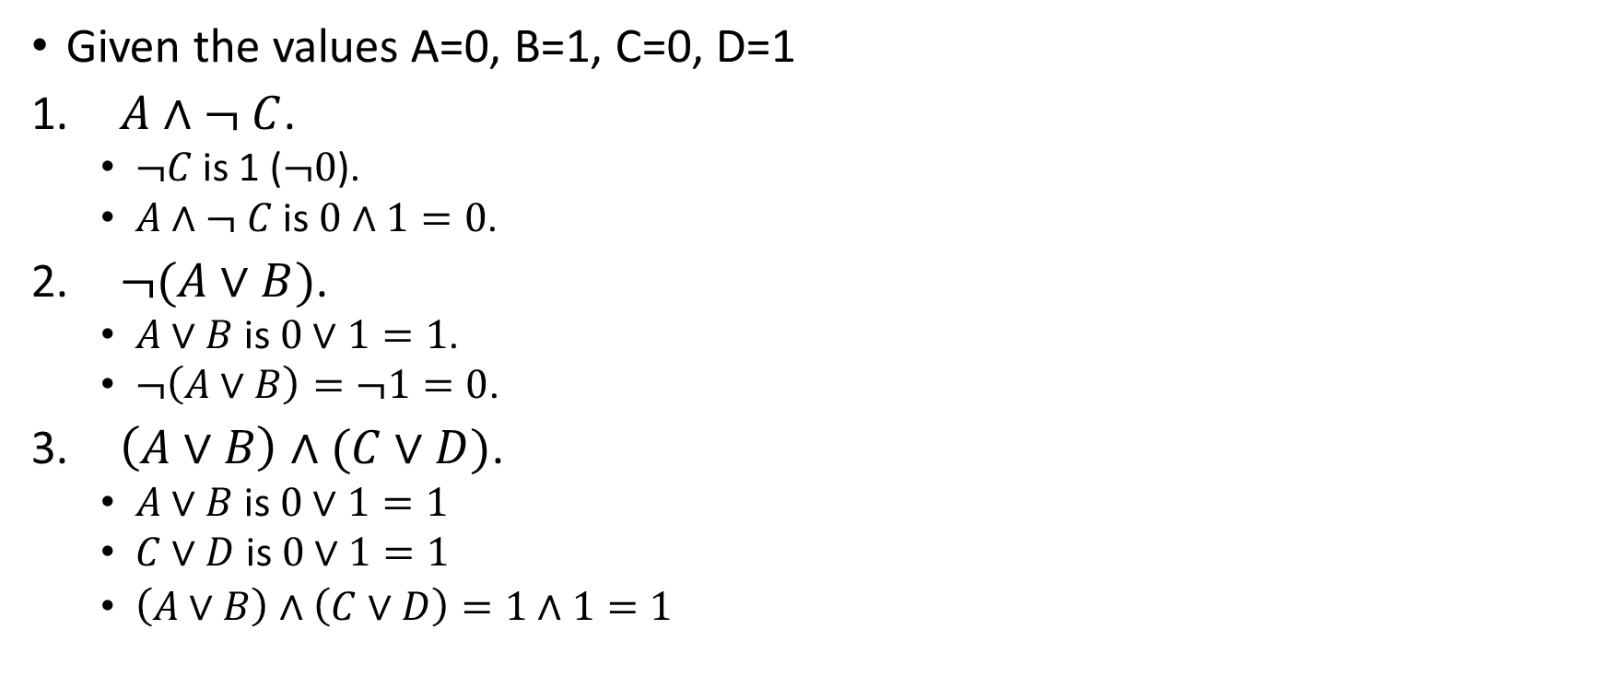
Examples: Evaluation
Given the values A=0, B=1, C=0, D=1
$A∧¬ C$.
  $¬C$ is 1 ($¬0$).
  $A∧¬ C$ is $0∧1=0$.
$¬(A∨B)$.
  $A∨B$ is $0∨1=1$.
  $¬\left(A∨B\right)=¬1=0$.
$\left(A∨B\right)∧(C∨D)$.
  $A∨B$ is $0∨1=1$
  $C∨D$ is $0∨1=1$
  $\left(A∨B\right)∧\left(C∨D\right)=1∧1=1$

Slide 19
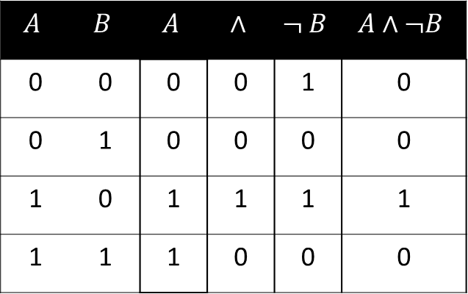
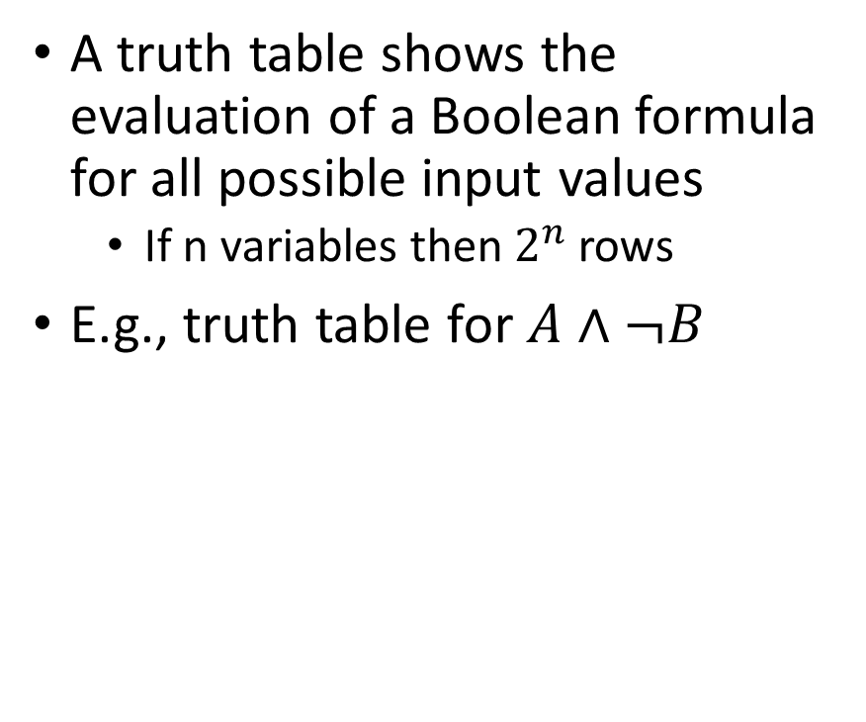
Truth Tables for Expressions
A truth table shows the evaluation of a Boolean formula for all possible input values
  If n variables then $2^{n}$ rows
E.g., truth table for $A∧¬B$
$$A$$ | $$B$$ | $$A$$ | $$∧$$ | $$¬ B$$ | $$A∧¬B$$
0 | 0 | 0 | 0 | 1 | 0
0 | 1 | 0 | 0 | 0 | 0
1 | 0 | 1 | 1 | 1 | 1
1 | 1 | 1 | 0 | 0 | 0

Slide 20
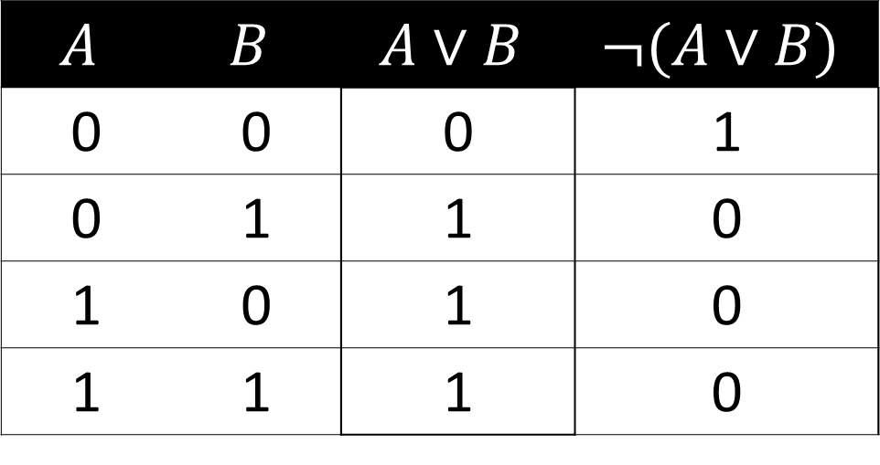

Example: $¬(A∨B)$
$$A$$ | $$B$$ | $$A∨B$$ | $$¬(A∨B)$$
0 | 0 | 0 | 1
0 | 1 | 1 | 0
1 | 0 | 1 | 0
1 | 1 | 1 | 0

Slide 21
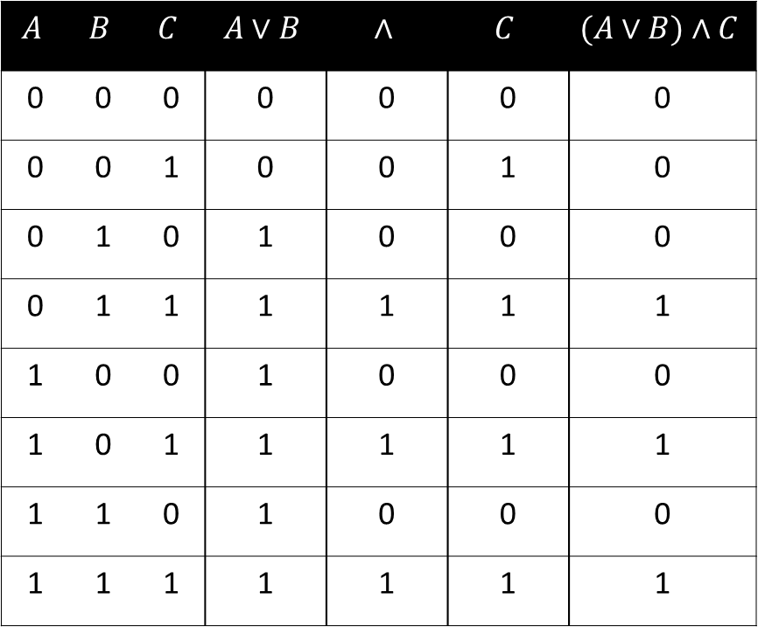

Example: $(A∨B)∧C$
$$A$$ | $$B$$ | $$C$$ | $$A∨B$$ | $$∧$$ | $$C$$ | $$(A∨B)∧C$$
0 | 0 | 0 | 0 | 0 | 0 | 0
0 | 0 | 1 | 0 | 0 | 1 | 0
0 | 1 | 0 | 1 | 0 | 0 | 0
0 | 1 | 1 | 1 | 1 | 1 | 1
1 | 0 | 0 | 1 | 0 | 0 | 0
1 | 0 | 1 | 1 | 1 | 1 | 1
1 | 1 | 0 | 1 | 0 | 0 | 0
1 | 1 | 1 | 1 | 1 | 1 | 1

Slide 22
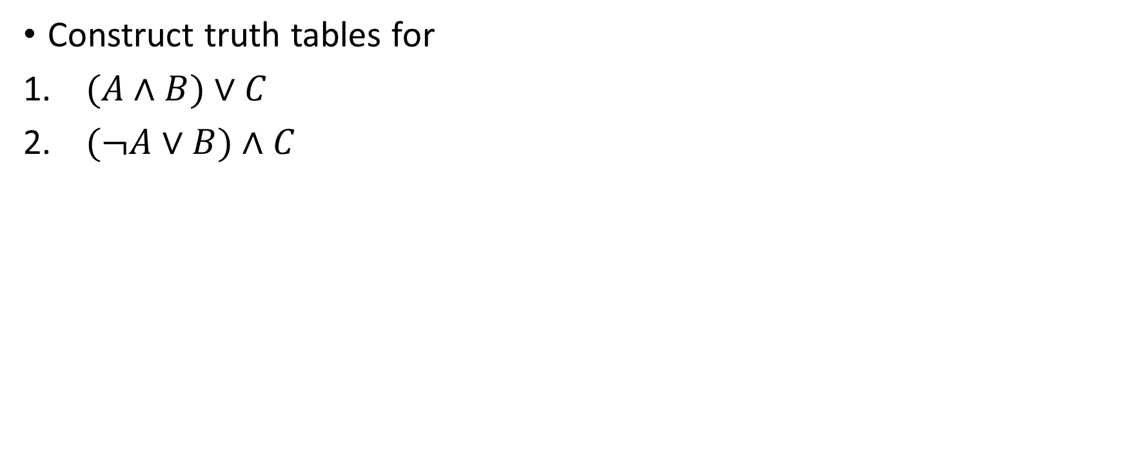
Exercise
Construct truth tables for
$(A∧B)∨C$
$(¬A∨B)∧C$

Slide 23
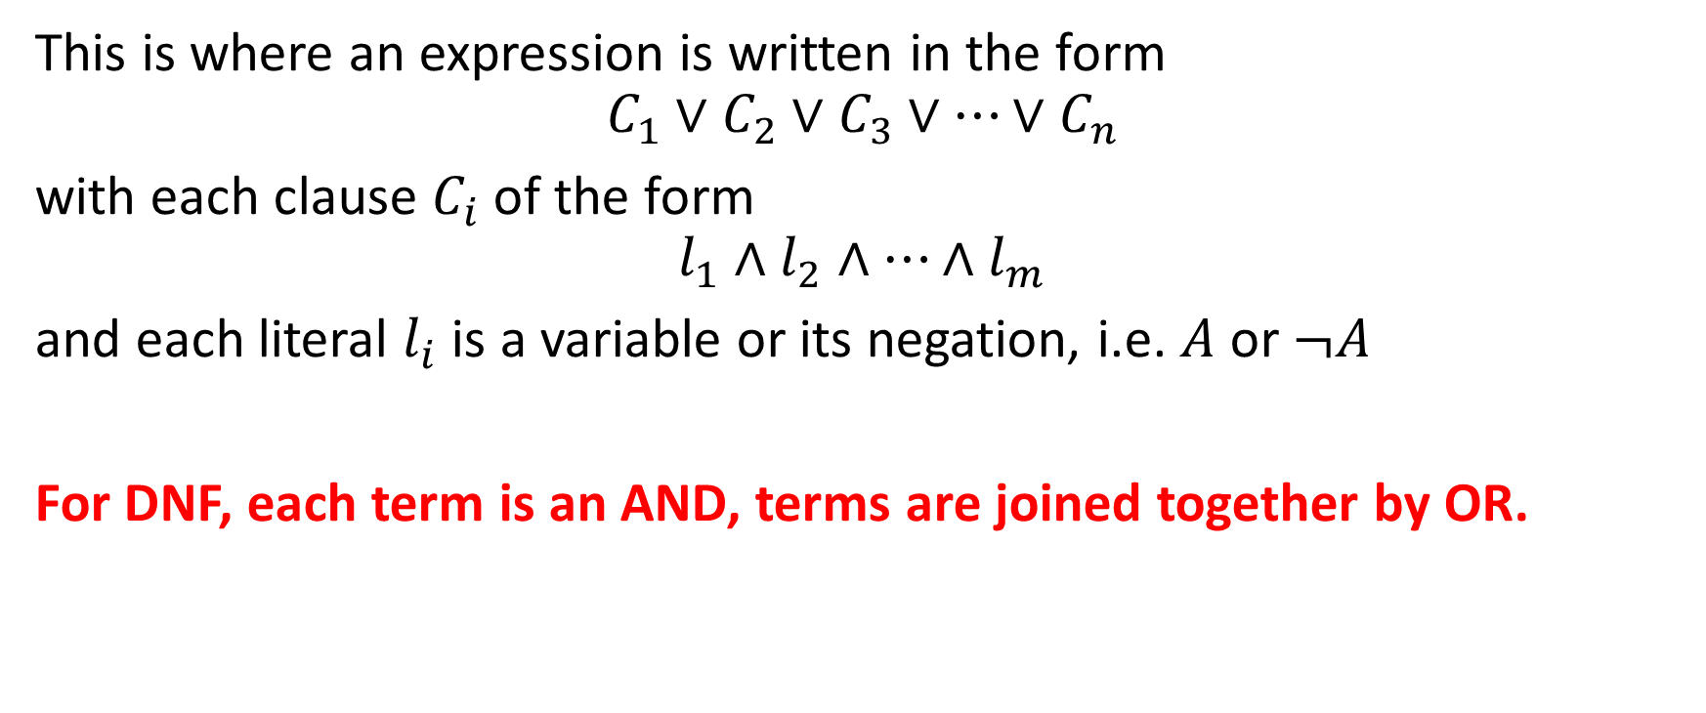
Disjunctive Normal Form (DNF)
This is where an expression is written in the form
$$C_{1}∨C_{2}∨C_{3}∨…∨C_{n}$$
with each clause $C_{i}$ of the form
$$l_{1}∧l_{2}∧…∧l_{m}$$
and each literal $l_{i}$ is a variable or its negation, i.e. $A$ or $¬A$
For DNF, each term is an AND, terms are joined together by OR.

Slide 24
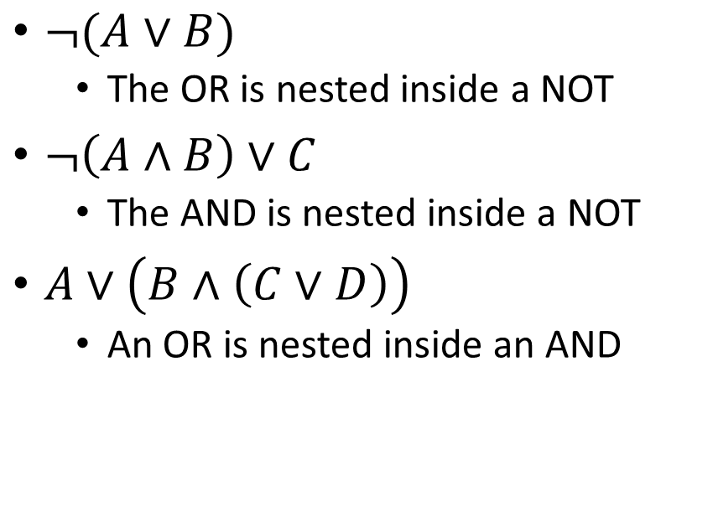
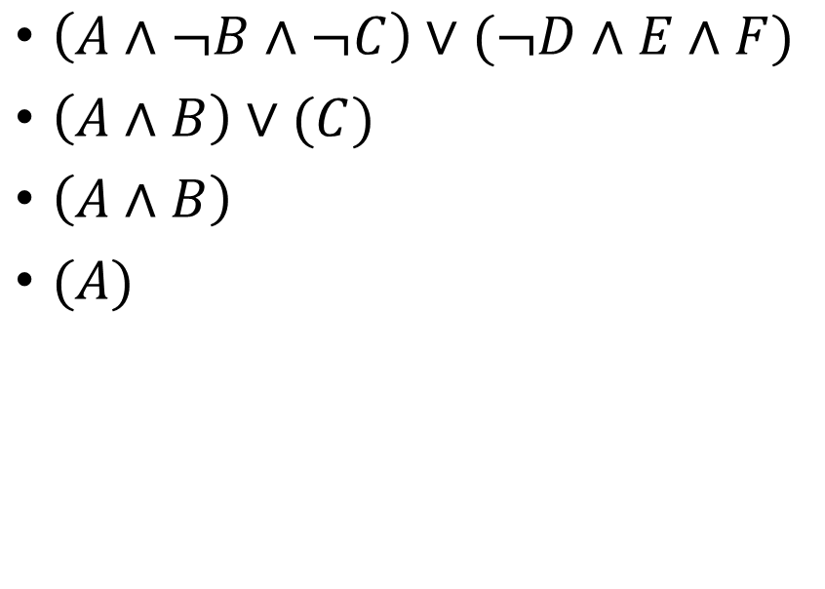
Examples
The following are in DNF
The following are not in DNF
$\left(A∧¬B∧¬C\right)∨(¬D∧E∧F)$
$\left(A∧B\right)∨(C)$
$\left(A∧B\right)$
$(A)$
$¬(A∨B)$
  The OR is nested inside a NOT
$¬\left(A∧B\right)∨C$
  The AND is nested inside a NOT
$A∨\left(B∧\left(C∨D\right)\right)$
  An OR is nested inside an AND

Slide 25
Converting to DNF
Use truth table
Pick out rows where output is 1
If input in row is 0, then negate the corresponding variable
Note: This will not produce a minimal DNF expression!

Slide 26
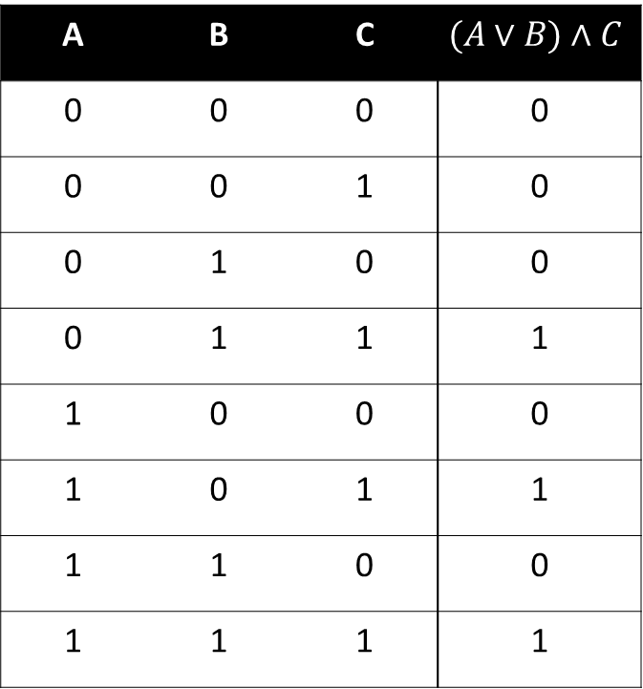
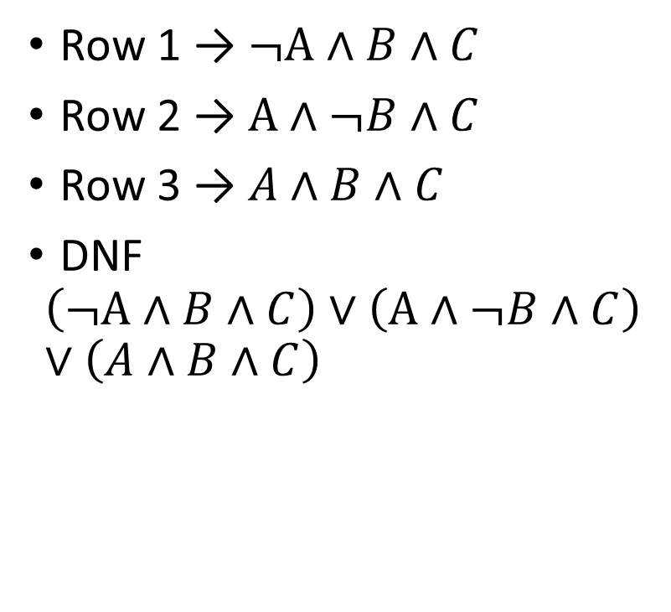
Example
A | B | C | $$(A∨B)∧C$$
0 | 0 | 0 | 0
0 | 0 | 1 | 0
0 | 1 | 0 | 0
0 | 1 | 1 | 1
1 | 0 | 0 | 0
1 | 0 | 1 | 1
1 | 1 | 0 | 0
1 | 1 | 1 | 1
Row 1 → $¬A∧B∧C$
Row 2 → $A∧¬B∧C$
Row 3 → $A∧B∧C$
DNF
$$\left(¬A∧B∧C\right)∨\left(A∧¬B∧C\right)∨\left(A∧B∧C\right)$$
1
2
3

Slide 27
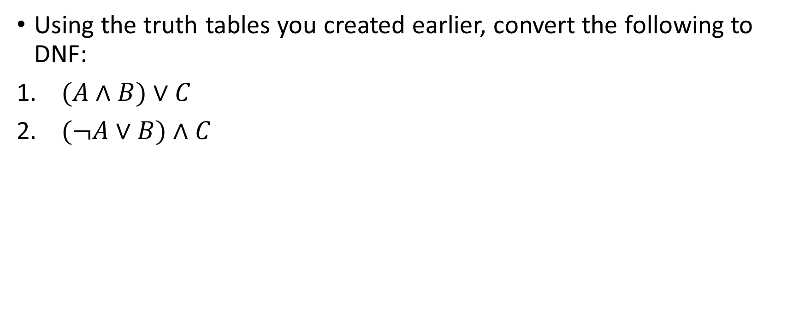
Exercise
Using the truth tables you created earlier, convert the following to DNF:
$(A∧B)∨C$
$(¬A∨B)∧C$

Slide 28
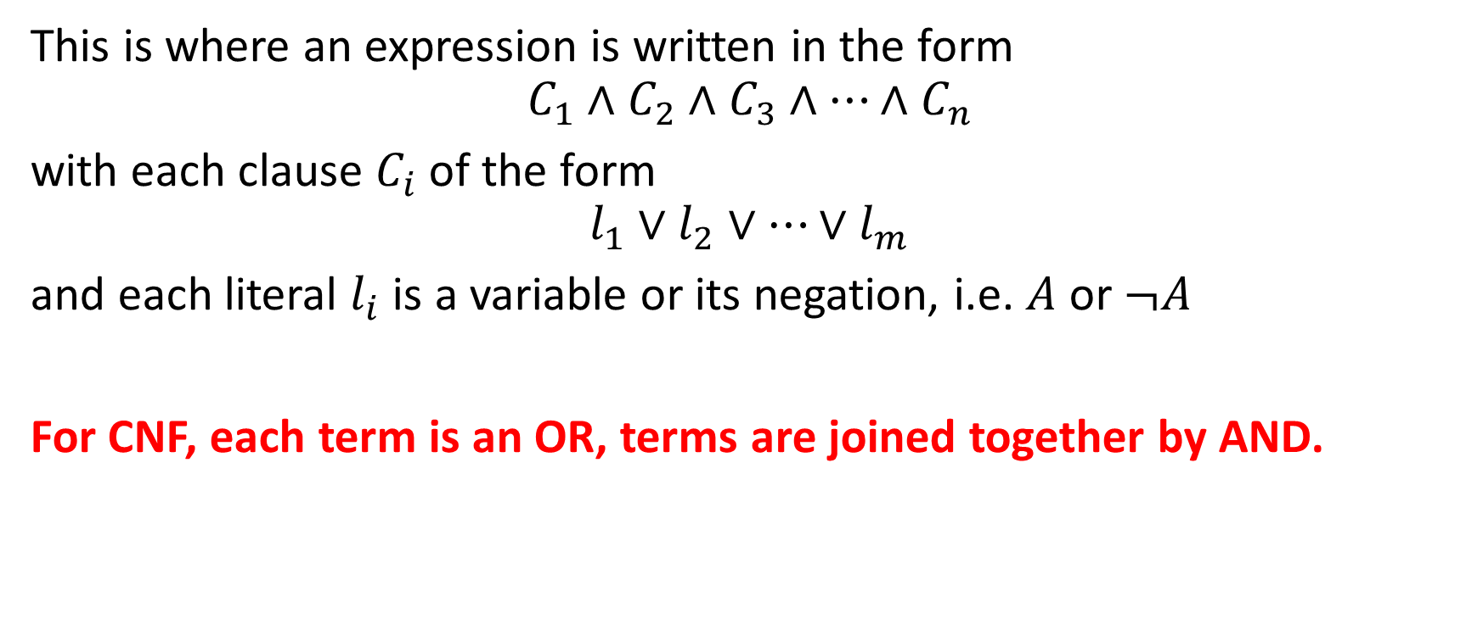
Conjunctive Normal Form
This is where an expression is written in the form
$$C_{1}∧C_{2}∧C_{3}∧…∧C_{n}$$
with each clause $C_{i}$ of the form
$$l_{1}∨l_{2}∨…∨l_{m}$$
and each literal $l_{i}$ is a variable or its negation, i.e. $A$ or $¬A$
For CNF, each term is an OR, terms are joined together by AND.

Slide 29
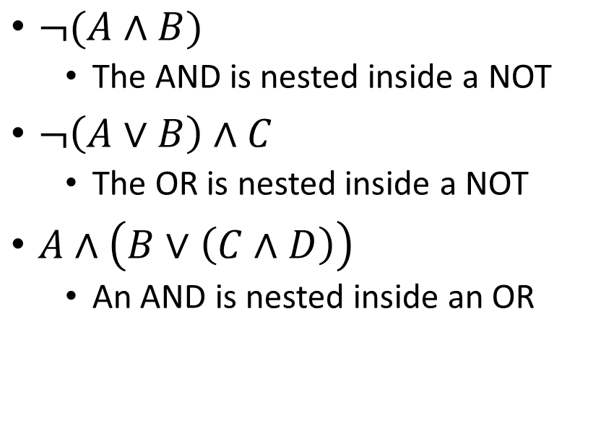
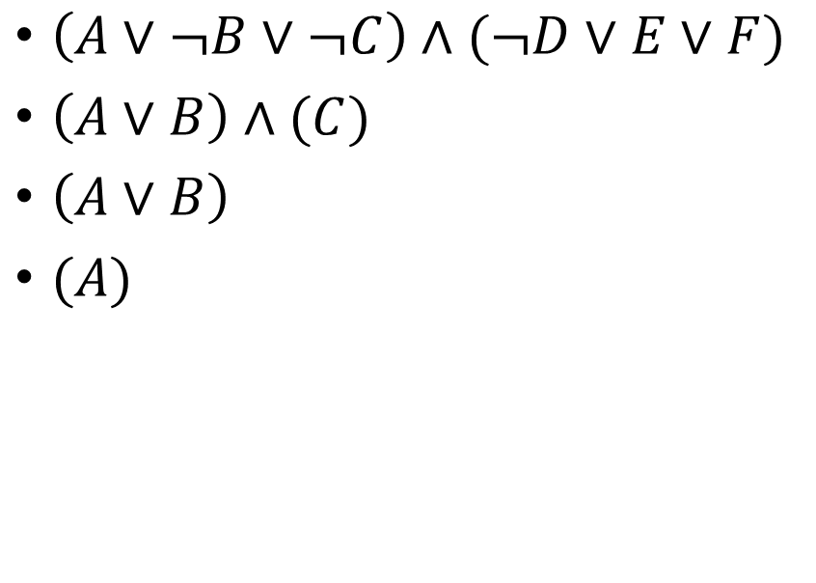
Examples
The following are in CNF
The following are not in CNF
$\left(A∨¬B∨¬C\right)∧(¬D∨E∨F)$
$\left(A∨B\right)∧(C)$
$\left(A∨B\right)$
$(A)$
$¬(A∧B)$
  The AND is nested inside a NOT
$¬\left(A∨B\right)∧C$
  The OR is nested inside a NOT
$A∧\left(B∨\left(C∧D\right)\right)$
  An AND is nested inside an OR

Slide 30
Converting to CNF
Use truth table
Pick out rows where output is 0
If input in row is 1, negate the corresponding variable
Note: This will not produce a minimal CNF expression!

Slide 31
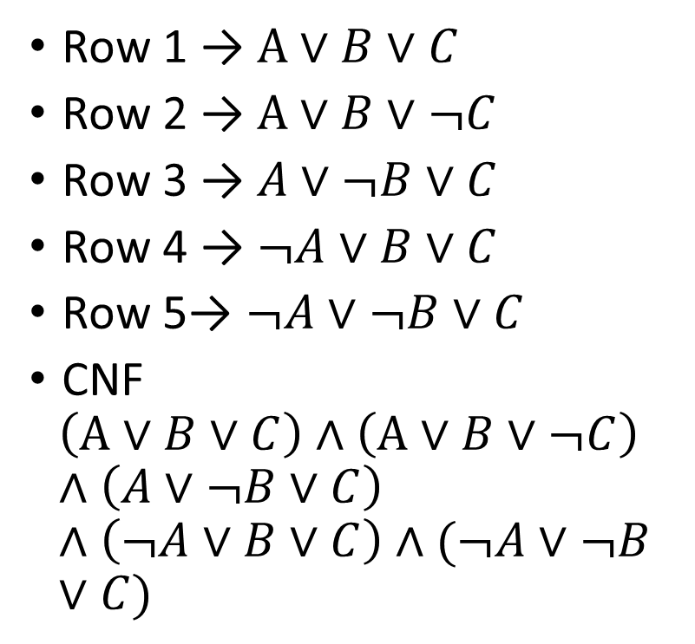
Example
A | B | C | $$(A∨B)∧C$$
0 | 0 | 0 | 0
0 | 0 | 1 | 0
0 | 1 | 0 | 0
0 | 1 | 1 | 1
1 | 0 | 0 | 0
1 | 0 | 1 | 1
1 | 1 | 0 | 0
1 | 1 | 1 | 1
Row 1 → $A∨B∨C$
Row 2 → $A∨B∨¬C$
Row 3 → $A∨¬B∨C$
Row 4 → $¬A∨B∨C$
Row 5→ $¬A∨¬B∨C$
CNF
$$\left(A∨B∨C\right)∧\left(A∨B∨¬C\right)∧\left(A∨¬B∨C\right)∧\left(¬A∨B∨C\right)∧(¬A∨¬B∨C)$$
1
2
3
4
5

Slide 32
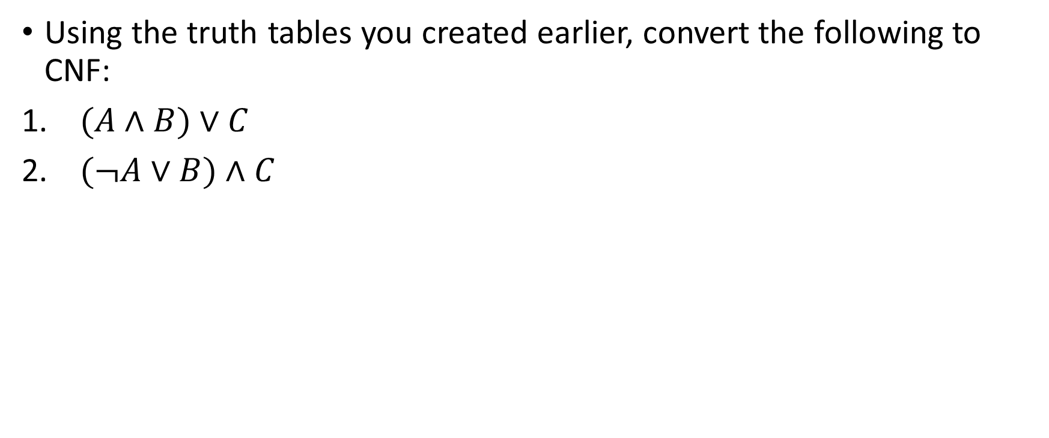
Exercise
Using the truth tables you created earlier, convert the following to CNF:
$(A∧B)∨C$
$(¬A∨B)∧C$

Slide 33
Logic Gates

Slide 34
Logic Circuits
Logic circuits are composed of logic gates wired together
Remember each gate corresponds to a logical operator

Slide 35
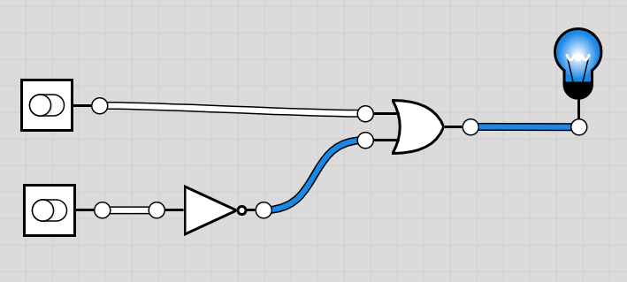

Example: $\left(A∨¬B\right)$

Slide 36
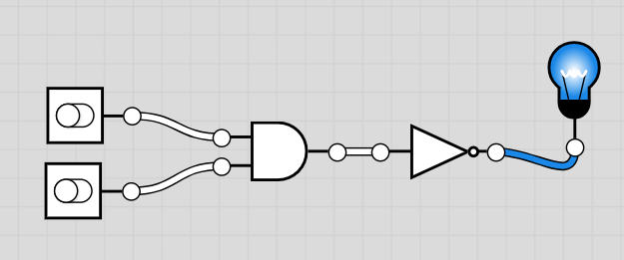

Example: $¬\left(A∧B\right)$

Slide 37
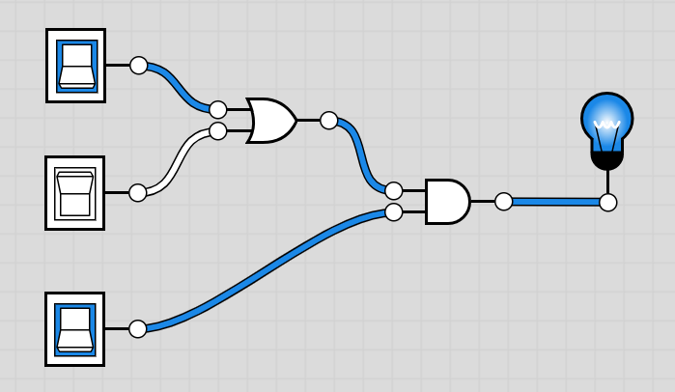

Example: $\left(A∨B\right)∧C$

Slide 38
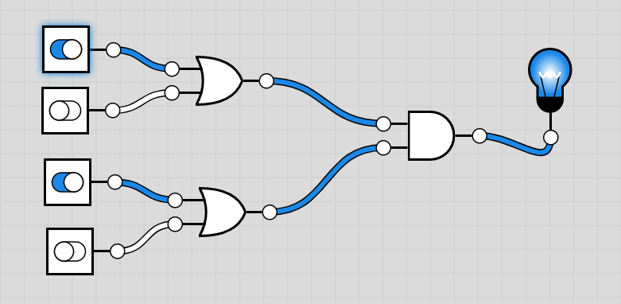

Example: $\left(A∨B\right)∧(C∨D)$

Slide 39
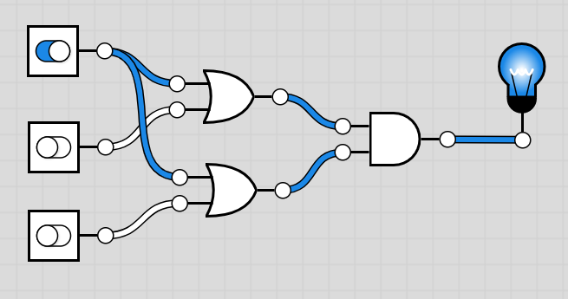

Example: $\left(A∨B\right)∧(A∨C)$

Slide 40
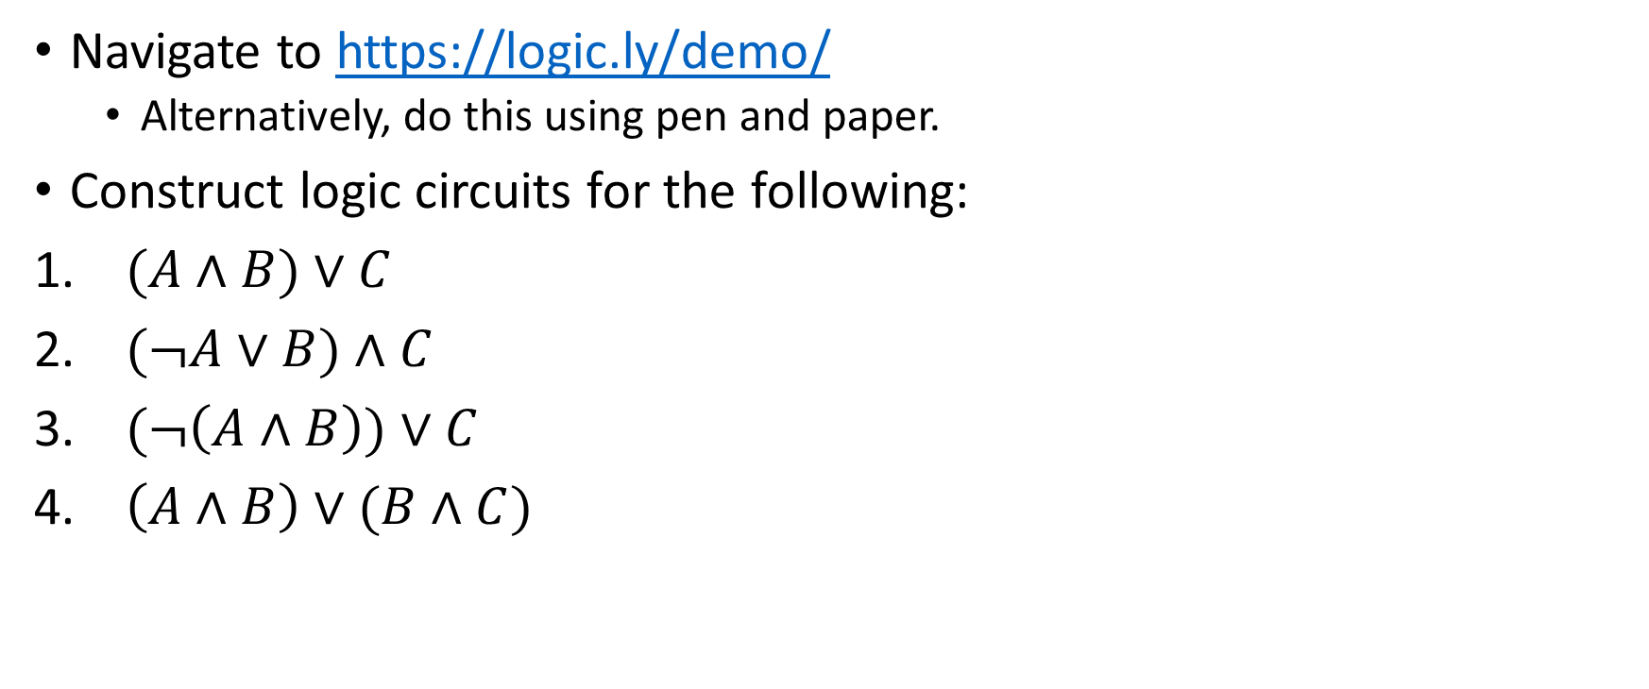
Exercise
Navigate to https://logic.ly/demo/
  Alternatively, do this using pen and paper.
Construct logic circuits for the following:
$(A∧B)∨C$
$(¬A∨B)∧C$
$(¬\left(A∧B\right))∨C$
$\left(A∧B\right)∨(B∧C)$

Slide 41
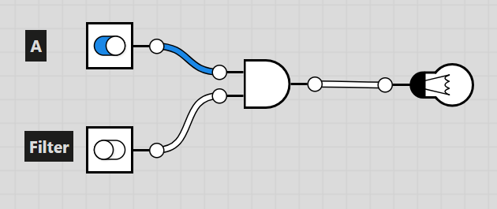
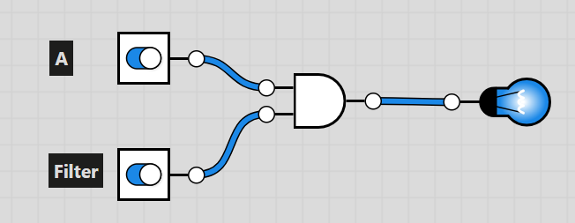
Example: Using AND gate to filter an input

Slide 42
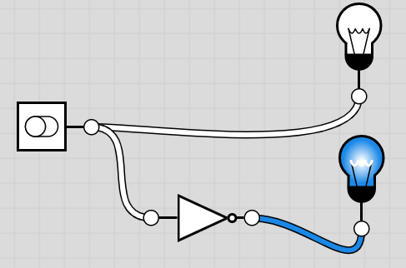
Example: Using NOT gate to create a selection input

Slide 43
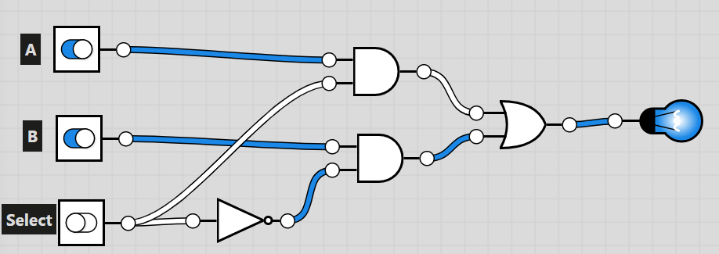
Example: Using OR gate to output one of two inputs

Slide 44
Summary
Boolean Logic
Logic Circuits

